Slide 1

3D Printing of
Multi-Material Hydrogels IIB Project Final Presentation, Division C
Nanoscience Centre, University of Cambridge
Senior Supervisor: Prof Shery Huang
PhD Student Supervisor: Yaqi Sheng
By Lorcan Nicholls ~ ln356@cam.ac.uk
1
Notes:
Hello, my name is Lorcan, I’ve been working in Shery’s group on 3D printing of multi-material hydrogels.

Slide 2






Presentation Outline
Introduction
Theory
Materials and Methods
Results
Applications
Conclusions
Notes:
I’ll start by introducing some background and the motivations for the project, then talk about the goals and the project itself, and then onto what the project has achieved and some of the potential applications of the research.

Slide 3
Introduction
What are multi-material hydrogels?
What has been done so far?
What is new about this work?
Introduction
Theory
Methods
Results
Applications
Conclusions
3
Notes:
So some background for the project…

Slide 4
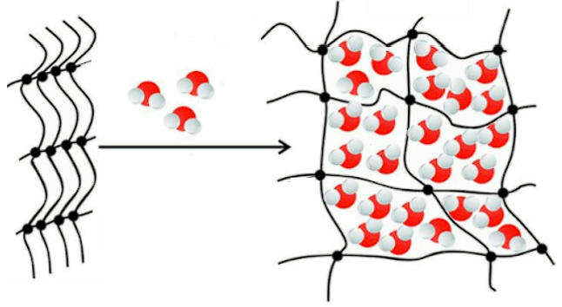
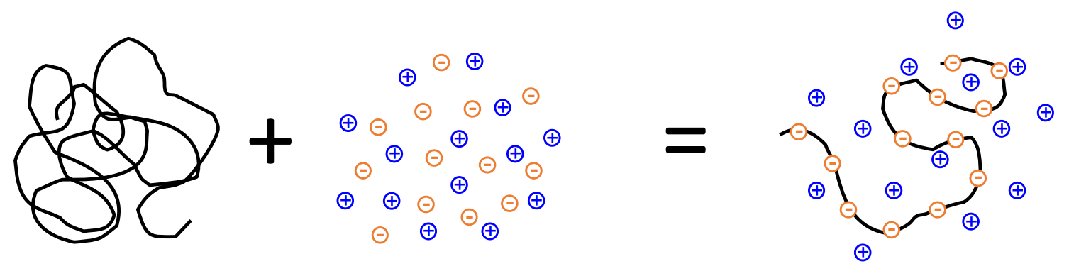
Hydrogels
Crosslinked biopolymers swell in water to form a solid structure
We aim to make hydrogels that can change their shape. How might this be done?
Biopolymer Aqueous Ionic Hydrogel
Electrolyte (Polyelectrolyte)
Ionisation is pH dependent → allows actuation
Problem: relies on a change in chemical environment
→ totally unsuitable for biomedical applications
Introduction
Theory
Methods
Results
Applications
Conclusions
4
Notes:
1) Many of us will be familiar with hydrogels, they’re what you get when you have a biopolymer that through either a chemical or a physical process can swell in water to form a soft solid material.
The goal of this project is to produce hydrogels that can change their shape, using 3D printing techniques. So how could this be done?
2) One way that’s been done in the past has been by exploiting the crosslinking of the hydrogel, you can see that by adding different concentrations of salts or electrolytes, and due to the ionizable or reactive side groups on the polymer chain, it becomes more favourable to change the configuration of these polymer chains from compact to swelled 3) and the degree of ionization can also be controlled by pH since that also affects ionization
4) But one of the main applications of using hydrogels is in applications where you need full compatibility with biological materials and so a big problem with this is it requires a change in the chemical environment to achieve actuation. So the motivation for this project is that we need some other way to do it.

Slide 5
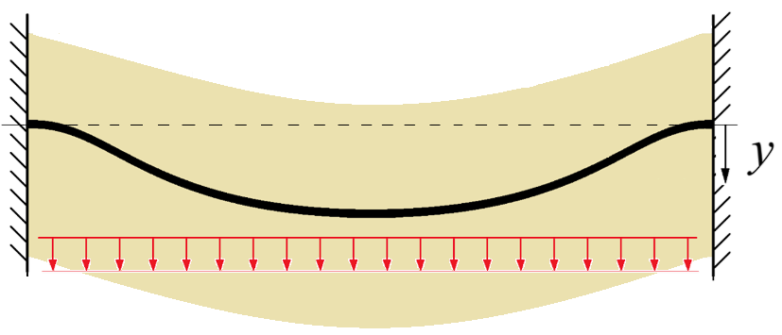
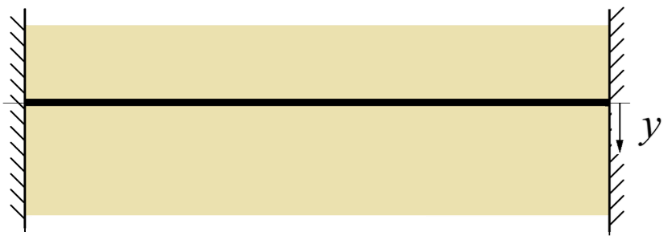
Biocompatible Actuation of Hydrogels
True biocompatibility requires homeostasis
Integrate hydrogels with functional materials like magnetic fibres:
An externally applied magnetic field can displace the hydrogel
shape change
(actuation)
If the fibres are nontoxic, this system
retains biocompatibility
Introduction
Theory
Methods
Results
Applications
Conclusions
5
Notes:
1) The approach was to try a composite hydrogel where we would include functional materials which are well known for smart actuation purposes and one of the simplest choices was magnetic materials, 2) and so the setup we came up with was to have flexible fibres with a magnetic material inside, and then surround that with the hydrogel. 3) With this arrangement, if an external magnetic field is applied and if the material properties are suitable then the idea is that the magnetic fibre will be pulled down due to magnetism and if there is a good interface between the hydrogel and the fibres then 4) the hydrogel will also be pulled down with it, and this is what I mean by actuation. 5) If the fibres are made in a nontoxic coating then this overall system will retain the biocompatibility of the hydrogel which is the key advantage over the environment dependent method.

Slide 6
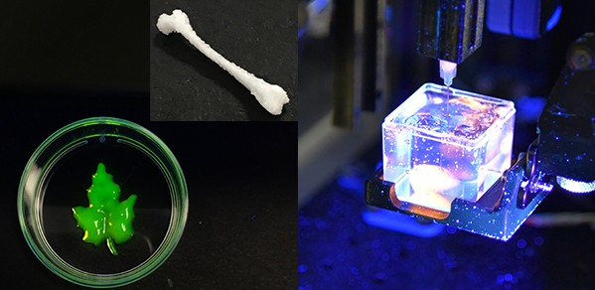
3D Printing of Magnetic Hydrogels
Implants that become part of a person’s natural tissues over time
★ Key Project Goal ★
If we can similarly automate the production of magnetic fibres, we can
3D print the composite hydrogels.
Applications:
1) In vitro lung models
2) Smart biomedical textiles
Shery’s group has already built a 3D bioprinter (Printer.HM) for extruding soft materials in the Nanoscience centre. [1]
Introduction
Theory
Methods
Results
Applications
Conclusions
6
Notes:
If we can develop a method of extruding both the hydrogel and these magnetic fibres automatically then we will have developed a composite that is suitable for 3D printing. Luckily Shery’s group has already built a 3D bioprinter called Printer.HM which can extrude many soft materials including hydrogels, so the main goal of this project is automating the production of thin magnetic fibres and combining them with suitable hydrogels to produce those composites.
These materials could be really useful in a variety of biomedical science applications like simulating the breathing motion of lung tissue so that’s an in vitro model organoid and also in the development of devices used to make smart textiles which can adapt their shape to aid in surgery so that would be an in vivo application. I’ll discuss a little bit more about this later as well.

Slide 7
Theory
Structural Analysis
Computational Modelling
Material Selection
Introduction
Theory
Methods
Results
Applications
Conclusions
7
Notes:
So with that as background I’ll discuss the theoretical basis of some of the work I did..

Slide 8
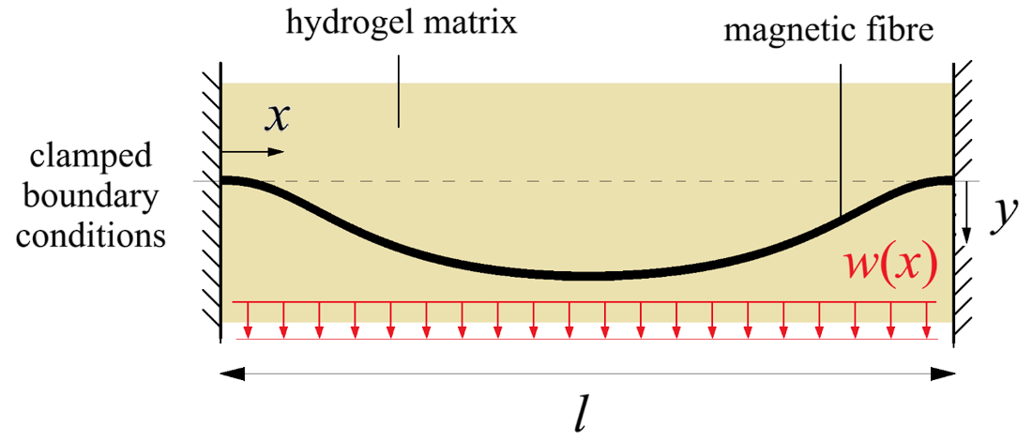
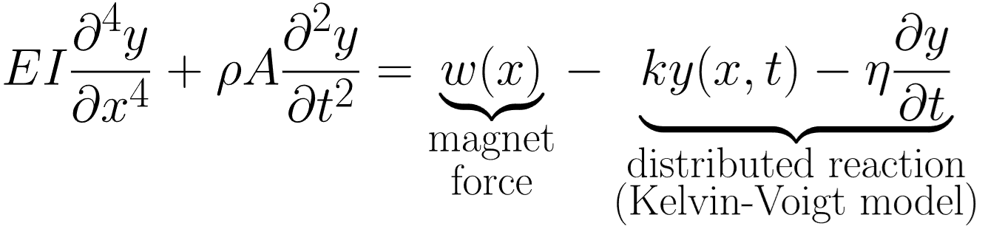
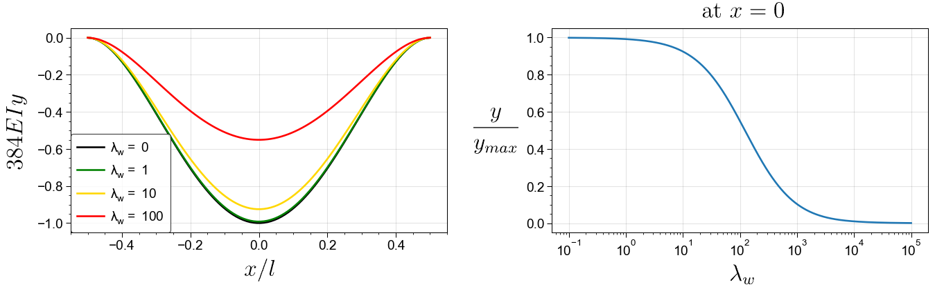
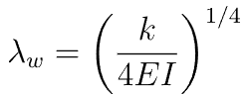
Structural Analysis of Magnetic Fibres
Beam theory with an additional contact force from the hydrogel
Assume a clamped elastic beam surrounded by a soft hydrogel medium. The hydrogel exerts a viscoelastic reaction force on the displaced fibre [2]
Steady state
(k: hydrogel stiffness per unit length, E: fibre modulus,
I: fibre second moment of area)
Hydrogel force ky must not cause it to fail
Compliant hydrogels do not impede the motion
Introduction
Theory
Methods
Results
Applications
Conclusions
8
Notes:
So if we want to investigate the potential deflections of a composite that could be achieved, the simplest thing to do would be looking at the forces acting on the magnetic fibre and apply the techniques of Euler-Bernoulli beam theory.
This is the equation modelling the displacement of the fibre relative to the horizontal position. The left hand side is the free vibrations of the beam and then we have the magnetic force pulling on the fibre, and if this fibre was freely hanging in air then that would be everything but because it’s immersed in this hydrogel we also have a resisting reaction force which we can model as a distributed linear spring of stiffness k and also a dashpot which would capture the viscoelastic behaviour that we know hydrogels often have.
But if the time scales of our system are fast enough we can just look at the steady state behaviour which turns this into a simple differential equation.
With suitable boundary conditions to reflect the setup I used we can solve this equation to get the shape you would expect, and we can also investigate how that peak displacement varies with the material properties of the hydrogel. 4) So when the stiffness of the hydrogel is small compared to the flexural rigidity of the fibres we are going to see almost unimpeded displacements which is what we aim for. We just also need to ensure that the force exerted on the hydrogel which is the ky term doesn’t cause the fibres to cut through the hydrogel so there’s an additional criterion to meet there.

Slide 9
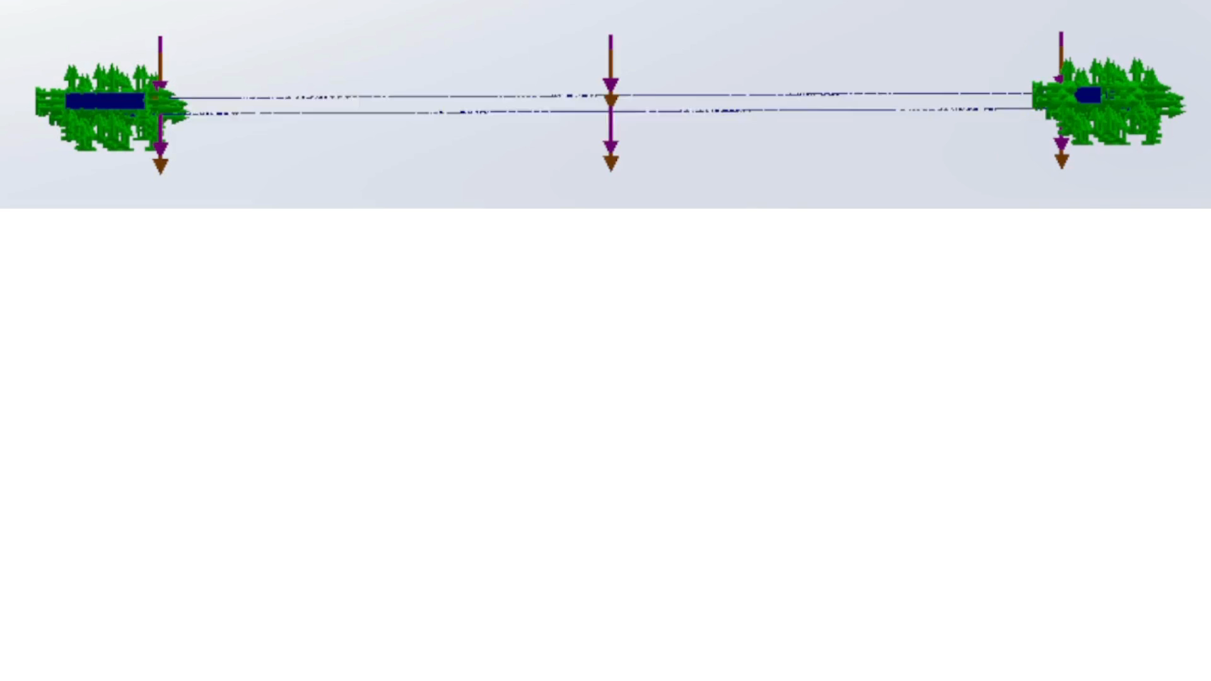
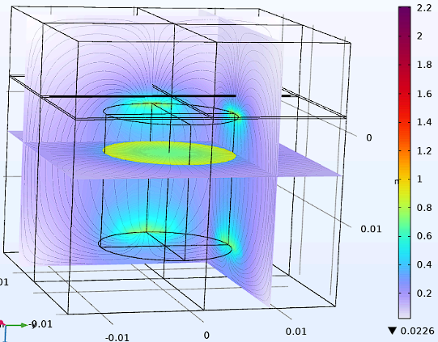
Computational Modelling
Captures the nonlinear magnetomechanical coupling
Solidworks: simple structural FEA
COMSOL: complex multiphysics
fibre
Useful for checking feasibility of setup
But precise calculations are hard because
material properties are highly variable!
electromagnet
Introduction
Theory
Methods
Results
Applications
Conclusions
9
Notes:
There were quite a few assumptions in that analysis and so the next step was to move to computational studies to see if we can replicate those calculations. This animation was made by doing an analysis in Solidworks and this was just a static analysis made to move for presentation its not actually moving like that it moves much faster in practice. This was done with a simple uniformly distributed load for the magnetic force.
I then tried the more complex software called COMSOL which can handle any combination of magnetism and viscoelastic materials and all the nonlinear interactions that come along with that. So I was able to simulate the magnetic field experienced by the fibres but unfortunately COMSOL is a pretty complicated software to use and I wasn’t able to model the whole system to figure out the displacements. But you can see the assumption of a uniform magnetic field across the fibre doesn’t hold perfectly true but it is good enough at least for order of magnitude calculations.
But the main issue with all of this is that the material properties themselves are highly variable since we’re working with micrometre scale structures they are quite sensitive to imperfections.

Slide 10
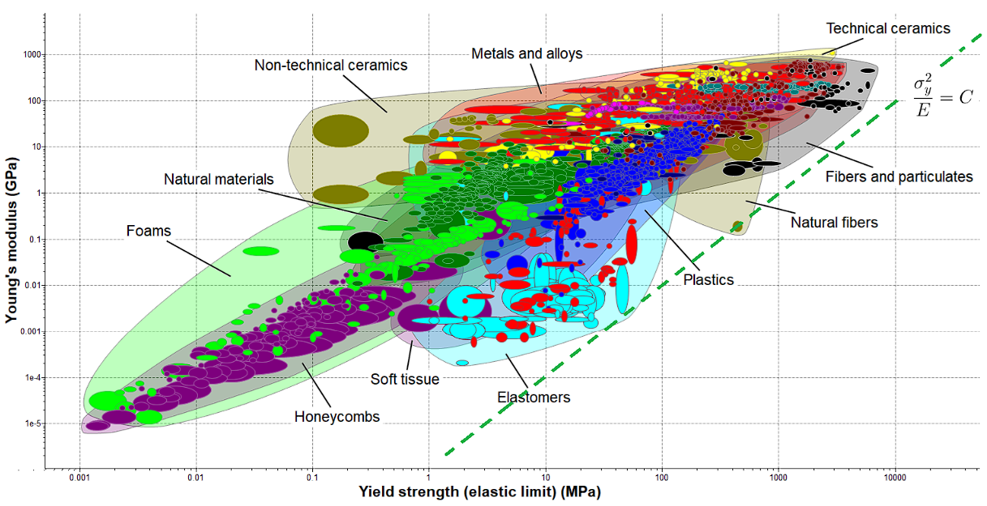
Material Selection
Stiffness-limited design, with many secondary constraints
The relevant failure criterion for this system is fatigue loading
Material property chart, using Ansys Granta L3 database
Rule of thumb: ensuring peak stress is less than half of yield stress will protect against high-cycle fatigue
Introduction
Theory
Methods
Results
Applications
Conclusions
10
Notes:
So if we consider the design of those materials, we can investigate the material selection process by first looking at the property charts for stiffness limited design and you can see the contours of the performance index in the dashed green line, and from this result I got from one of the databases in Ansys Granta we can see that materials that naturally form fibres actually optimise this index and so that’s another way to justify the choice of morphology as magnetic fibres and you can see that soft materials with high strain to failure also perform very well in the light blue bubble.
Keeping in mind that the goal is actuation, repetitive movements are going to be the normal operating stress condition and so fatigue failure is our main concern. To keep things simple I used the common assumption that if the peak stress in the fibre is less than half of its yield stress then the number of cycles to failure will effectively approach infinity and this is another condition that can be looked at using simple theoretical methods.

Slide 11
Materials and Methods
What materials were chosen?
How are the fibres made?
How are the composites made and tested?
Introduction
Theory
Methods
Results
Applications
Conclusions
11
Notes:
So here I’ll discuss what materials I did decide to investigate and how the magnetic composites were made and tested..

Slide 12
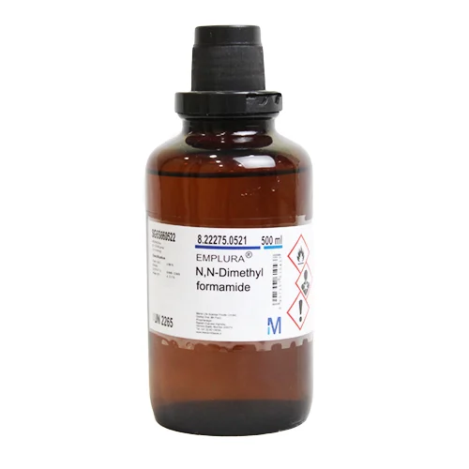
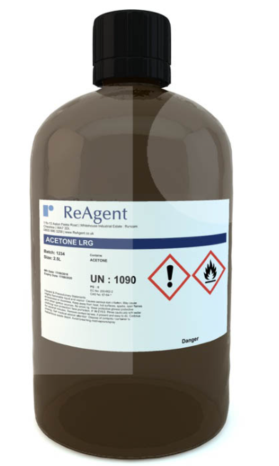
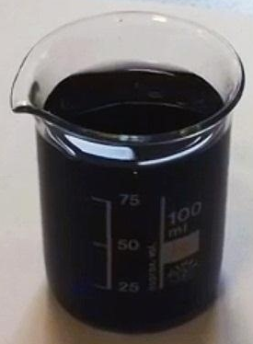
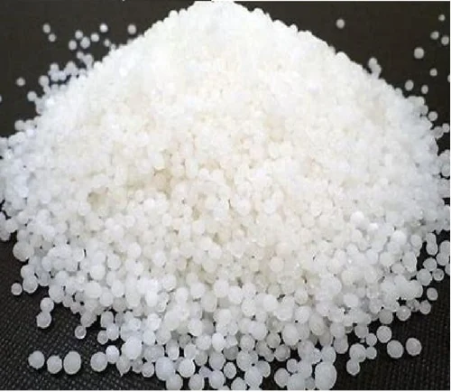
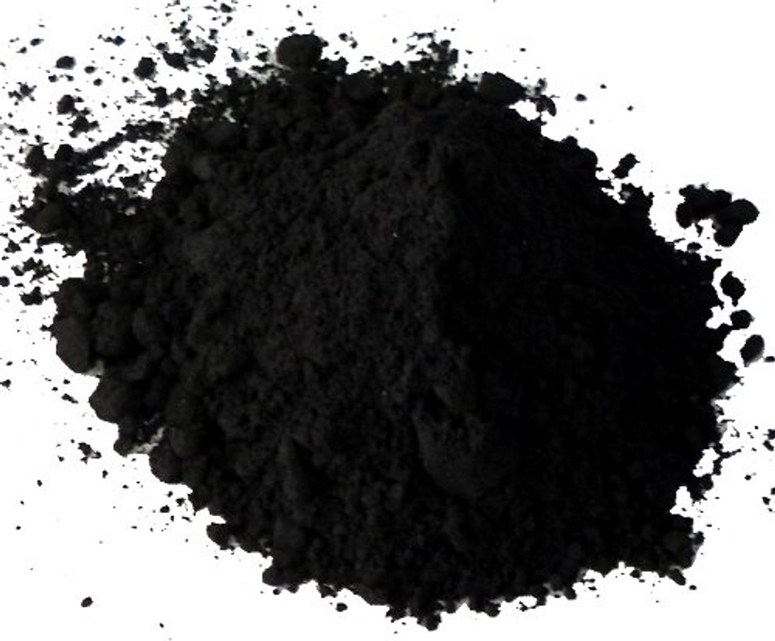

Fibre Compositions
Solvent + Polymer + Magnets
+
+
+
→
DMF
(N,N-dimethylformamide)
85% weight
Acetone
(propanone)
15% weight
Polystyrene
sets spinnability
Iron oxide
sets magnetism
Magnetic solution
Ready for nanospinning process
Polymer Filler
Magnets
Solvent
Introduction
Theory
Methods
Results
Applications
Conclusions
12
Notes:
1) So to make the fibres the method was based on the dry spinning approach which is where you have a solvent, and I chose a binary solvent of DMF and acetone, and to that solvent you add the polymer which will form the core of the fibres similar to threading of textiles is done, and then to get our magnetic functionality we add some magnetic powder and I chose iron oxide. Some other materials were trialled too but none of them worked as well as this one.
2) Combining the solvent, the polymer and the magnets together and heat and stir them to produce a thick black solution which we draw the fibres from.

Slide 13
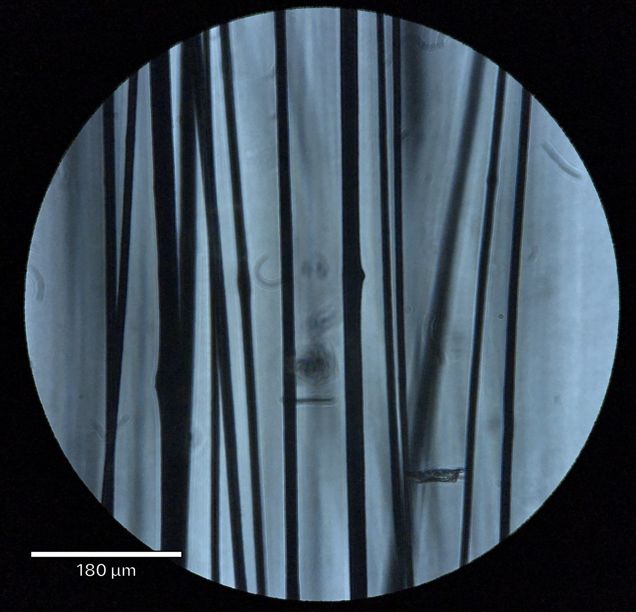
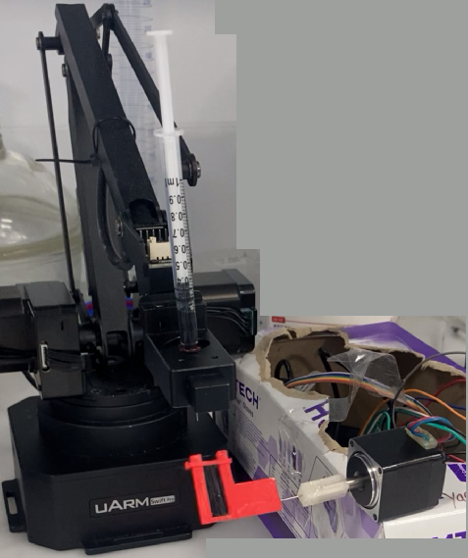
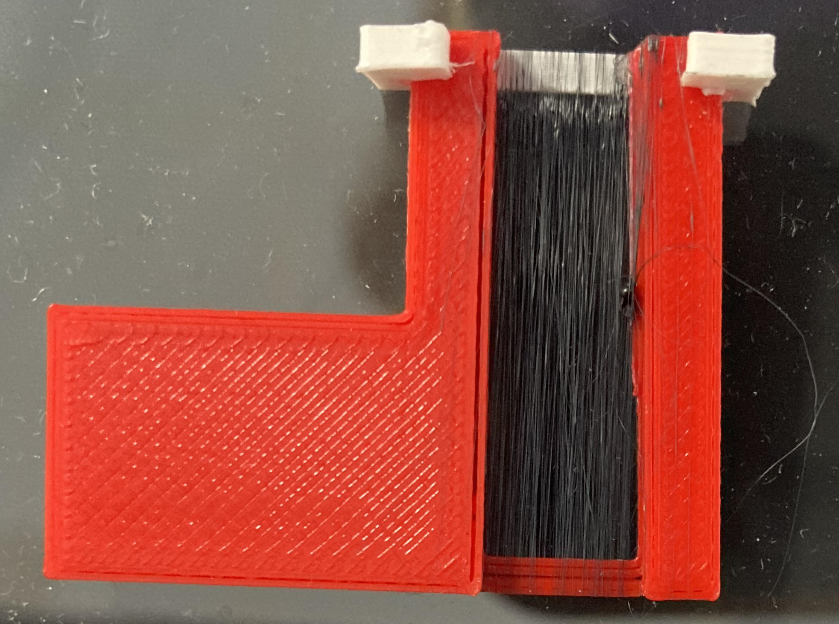
Fibre Spinning
Using a robot arm, syringe and spinning frame
Automated nanospinning
syringe full of fibre solution
robot arm
extruded fibres
spinning frame
diameter ~ 20 μm
Produces this in about
2 mins of spinning
Introduction
Theory
Methods
Results
Applications
Conclusions
13
Notes:
This is the setup for producing the fibres from that fibre solution
At the top we have a syringe containing the black solution being held by a robot arm, and at the bottom we have a specially designed 3D printed frame in red which is being spun around and around by an Arduino powered motor. The fibres get pulled out of the solvent in here and they get collected and wound onto this frame, and because the robot arm is programmed to move slowly from side to side, the fibres will end up slowly collecting all across the width of the frame.
Which you can see here, this is showing the freshly produced fibres running up and down
This is what is looks like under a microscope you can see the very consistently sized fibres all mostly parallel, the scale bar in this picture says 180 microns so the diameter of these fibres is about 20 microns, and this whole process takes only 1-2 minutes.

Slide 14
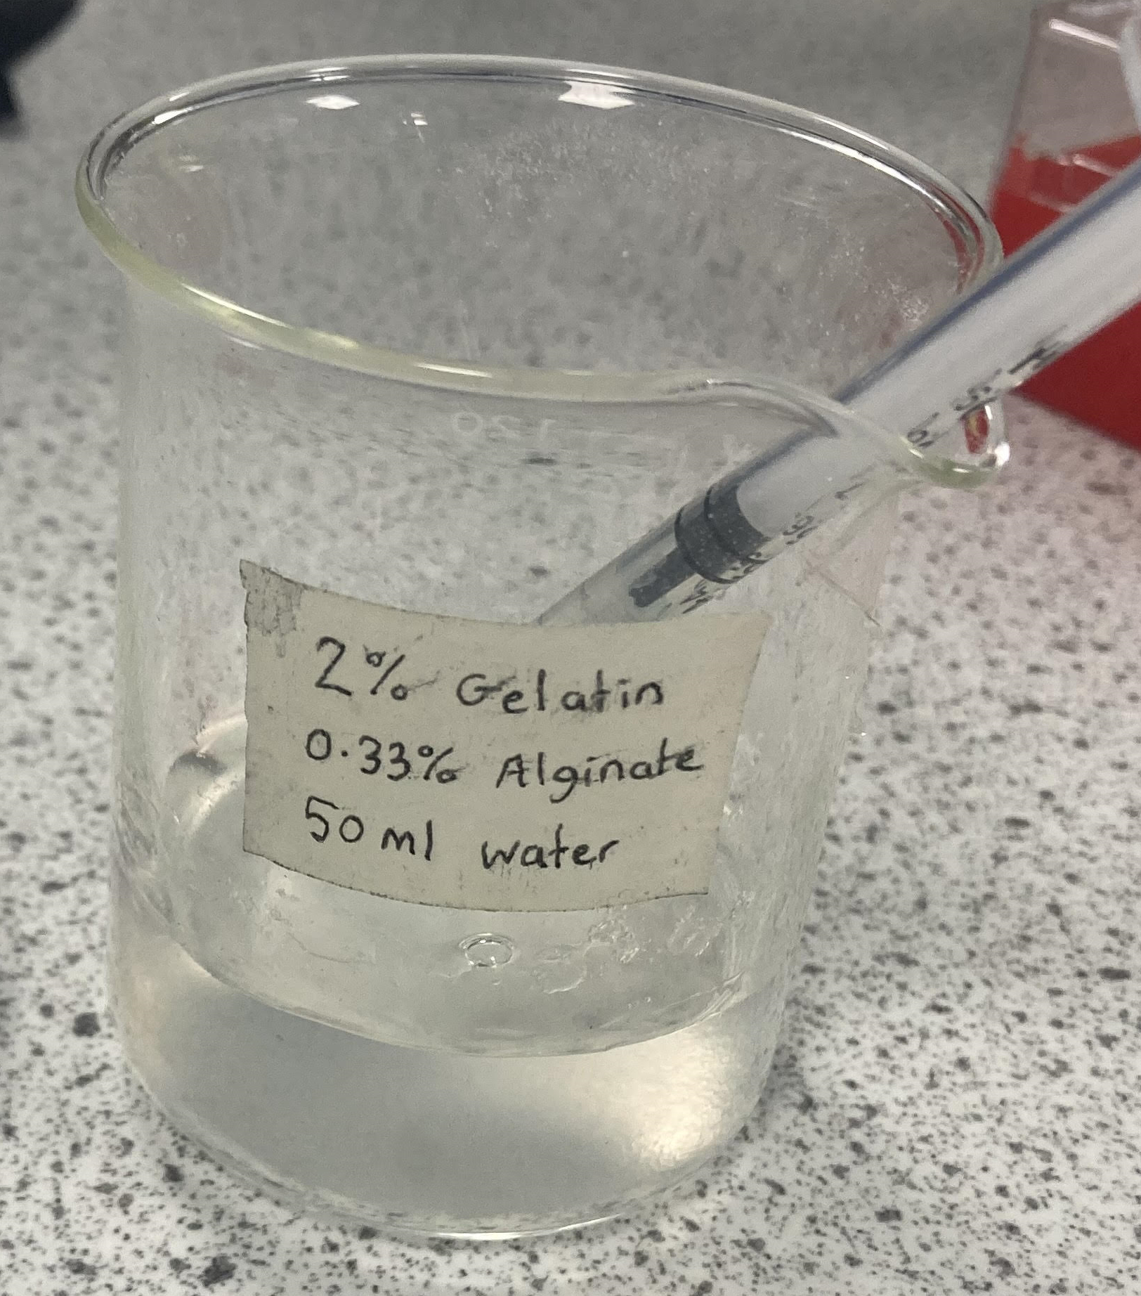
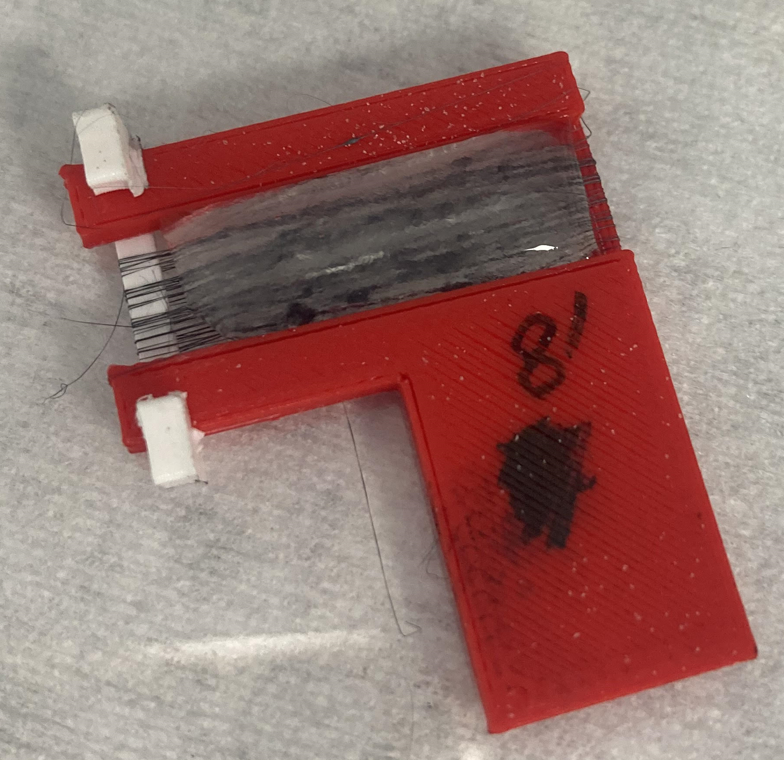
Hydrogel Compositions
Gelatin/Alginate as a Self-Crosslinking UCST Hydrogel
Making gelatin hydrogels is very simple: just mix the powders together in water
Printer.HM (3D bioprinter) extrudes hot liquid phase hydrogel which solidifies on the stage as it cools below its upper critical solution temperature (UCST)
By depositing the hydrogel onto the fibres, the composite can be prepared as the hydrogel surrounds the fibres.
Introduction
Theory
Methods
Results
Applications
Conclusions
14
Notes:
1) The second component is the hydrogels, and I chose a multi-component gelatin and alginate system which are both natural biopolymers.
2) Hydrogels are very simple to make, not much more than mixing the powders of the biopolymers together in water and stirring.
3) When you heat this particular type of hydrogel up to high temperature they melt into a hot two-phase liquid which the 3D printer can take as its ‘ink’, and as it cools it solidifies back into the hydrogel, but in the interest of time for these experiments there was nothing stopping me from just doing it by hand and placing a syringe full of the liquid hydrogel onto the fibres that I prepared earlier.
4) Since it was deposited in its liquid phase its going to surround those fibres completely and solidify into the composite structure that we wanted, so a very simple process.

Slide 15
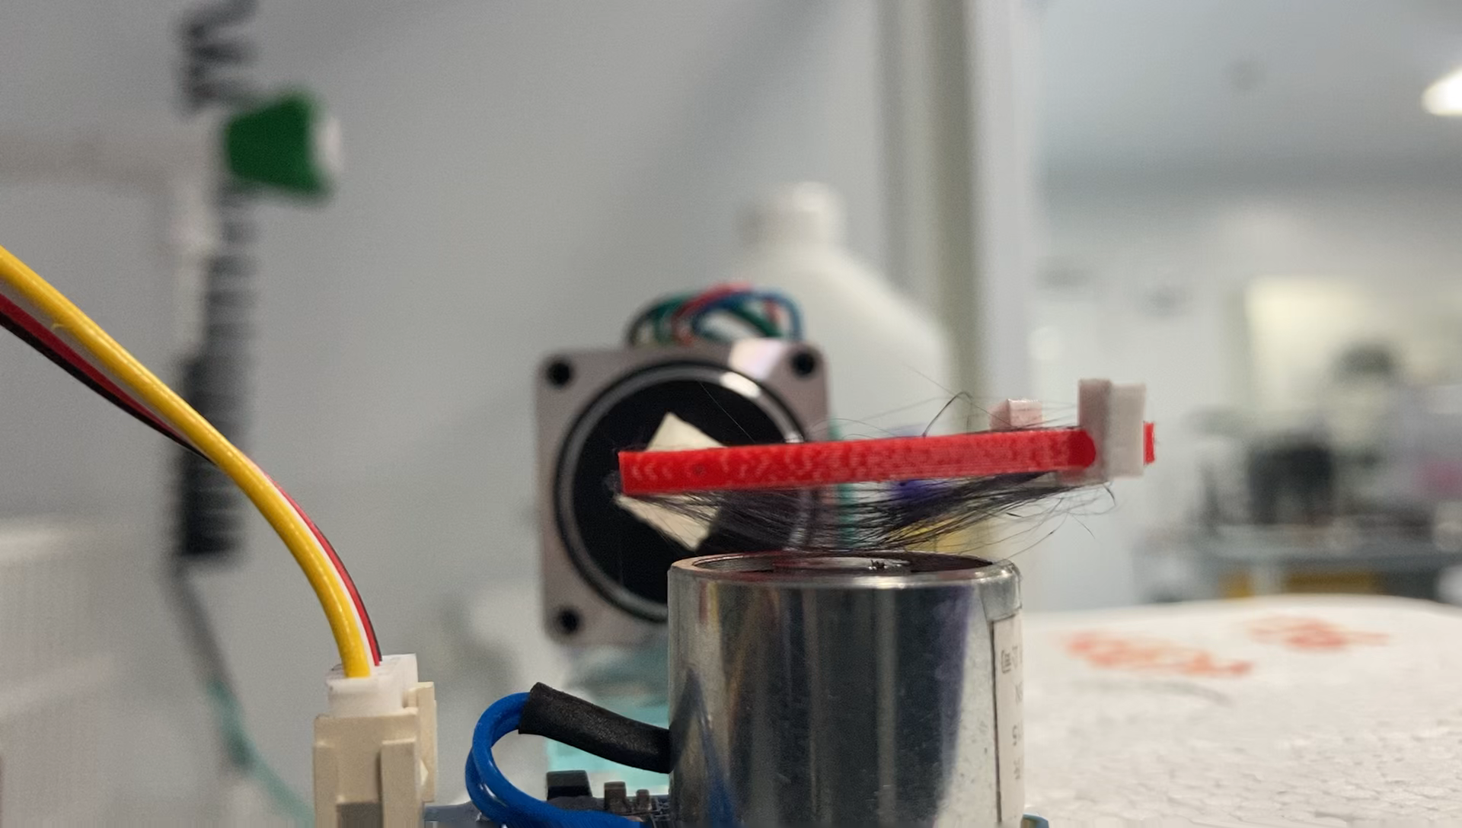
Testing the Magnetic Responsiveness
Use an electromagnet and measure the deflection
Electromagnet programmed to switch on and off
With a small contraction using the slider on the frame, the fibres will show large deflections in the magnetic field
Introduction
Theory
Methods
Results
Applications
Conclusions
15
Notes:
Here’s how I tested the magnetic responsiveness, you can see how those fibres deflect in the frame using the electromagnet below and that magnet is programmed to switch fully on and fully off every second. You can see the response time is pretty much instant, there’s no time delay.
This is without the hydrogel on top, the response with the hydrogel is similar but just a bit smaller because of its elasticity.

Slide 16
Results
Which compositions were best?
How much do they deform?
Introduction
Theory
Methods
Results
Applications
Conclusions
16
Notes:
So what did we find from these experiments?

Slide 17
Best Compositions for Magnetic Fibres
Need ~50% solid in fibre solution, with most compliant hydrogel
‘Best’ means 1) good spinnability, 2) homogeneous fibres, 3) high deflection
Combinations of these variables were tested:
Polystyrene mass fraction: {10%, 20%, 30%}
Iron oxide mass fraction: {10%, 20%, 30%}
Gelatin/Alginate (6:1) mass fraction: {7%, 2.33%, 0.33%}
Best fibre solution: using 20% polystyrene and 30% iron oxide
Best hydrogel: 2% gelatin and 0.33% sodium alginate in DI water
Introduction
Theory
Methods
Results
Applications
Conclusions
17
Notes:
I used both qualitative and quantitative metrics to judge the different materials, such as how reliably the fibres can be spun, how consistent those fibres are in their morphology, and what the maximum deflections attained by the hydrogel and fibres in a magnetic field are.
To test a wide range of compositions, I essentially did the experiments on a grid of these different percentages of each part, so lots of different possibilities to test.
Over all three of the metrics I mentioned, I found that this particular composition did really well, so 20% polystyrene, 30% iron oxide in the solvent, and then 2% gelatin and 0.33% alginate which was the most compliant hydrogel I could find that didn’t just collapse into a liquid.

Slide 18
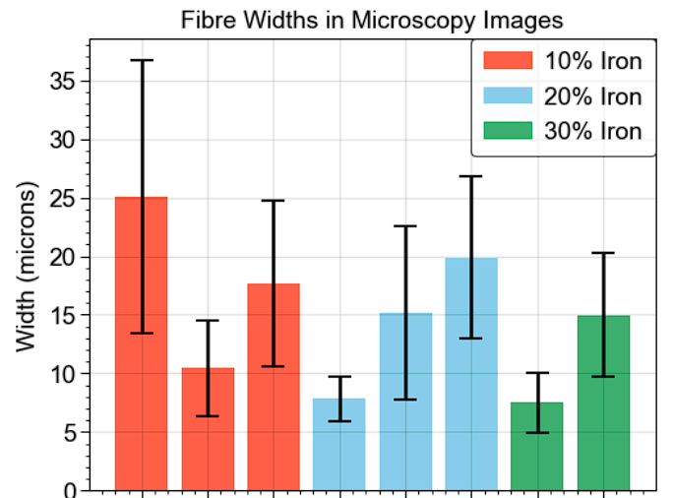
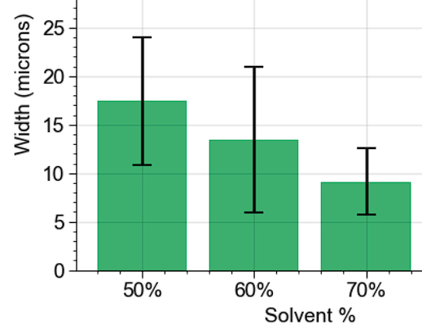
Homogeneity of Fibre Dimensions
Over the range of tested compositions, size was quite consistent
More polymer/iron in the solution usually gives
thicker fibres
Fibres are fairly homogeneous in general
10% 20% 30% 10% 20% 30% 10% 20%
Polystyrene mass fraction in fibre solution
Introduction
Theory
Methods
Results
Applications
Conclusions
18
Notes:
Here’s some data regarding the consistency of the fibre size, you can see the average fibre diameter hovers around 15 microns, with a standard deviation about 30%.
You can see that’s quite consistent across most of the compositions. There is a mild trend that the more solvent you have, equivalently the less solid you have, the thinner the fibres get which makes sense, but the trend is not that strong overall.

Slide 19
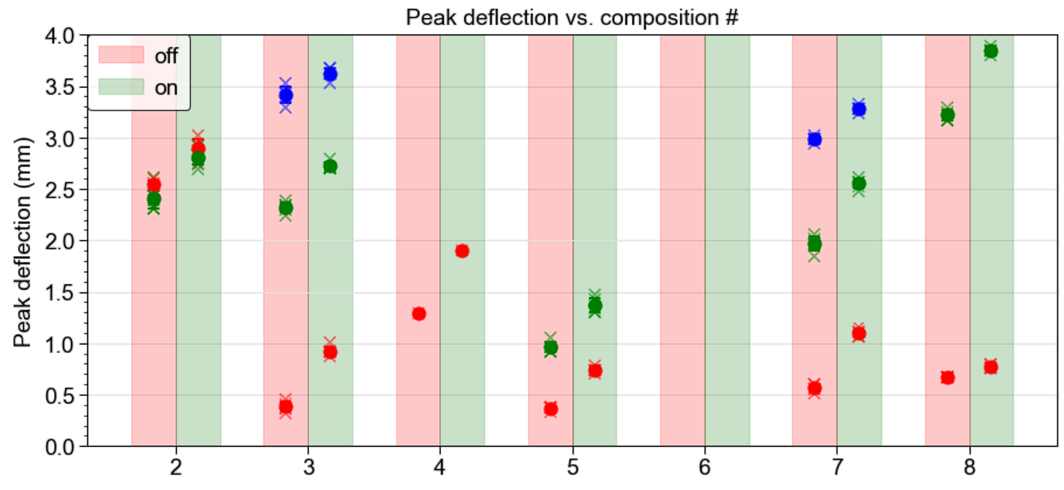
Magnetic Deflection Tests
A small contraction in length leads to much higher sensitivity
electromagnet state
(Dot colour represents a different contracted length of fibre)
Fibre length ~ 28 mm
Deflection ~ 1 mm
Strain ~ 5%
Reduced to about half when combined with the hydrogel
PS
Iron
20% 30% 10% 20% 30% 10% 20%
10% 10% 20% 20% 20% 30% 30%
Introduction
Theory
Methods
Results
Applications
Conclusions
19
Notes:
Here are the results of the deflection tests in a magnetic field, I collected lots of data by filming it with a camera and the dots show the mean transverse displacements from the horizontal position.
If we just zoom in one of these to look at…
This very small increase between the red dots shows what happens if you turn the magnet on with the fibres at their full length.
But by manually contracting the fibres using the custom frame we printed, we can release the tension in those fibres and allow them to hang a little bit more freely, so that naturally gives more displacement shown by the vertical arrow…
And now if we turn the magnet on from this state we can see there is a much larger response from the fibres which is very easy to do and useful.

Slide 20
Applications
In vitro lung model organoids
Smart biomedical textiles
Introduction
Theory
Methods
Results
Applications
Conclusions
20
20
Notes:
So could this be useful for?

Slide 21
Applications of Soft Actuators
Combines remote movement with biocompatibility
Can combine with other projects demonstrated from this group
(cryoprinting, fibre printing robot…) to fully realise 3D printing capabilities
Application #1: Lung Organoids
Hydrogel loaded with cells could experience actuation to simulate lung tissue breathing in vitro, study cell-matrix mechanobiological interactions
Application #2: Smart Biomedical Textiles (+ Regenerative Medicine?)
Using bioresorbable hydrogels as post-surgical cavity fillers to prevent internal adhesions by moving into place, reducing patient complications
Introduction
Theory
Methods
Results
Applications
Conclusions
21
Notes:
There are lots of possibilities for soft actuators which is effectively what’s been made
One of the immediate next steps might be to combine this work with what’s been demonstrated in other projects shown today, such as the cryoprinting, or the fibre printing robot or the soft material tensile testing machine, those could be used to fully flesh out the 3D printing capabilities.
Thinking further ahead to potential research applications, there are systems called organoids that are widely used in the pharmacodynamic studies of drug development and we could use the system we developed as a model lung where the remote actuation can simulate the breathing motion of the lung tissue, and its very easy to incorporate for example a seeding of epithelial cell into the hydrogel to study the cell-to-cell and cell-to-matrix interactions as well.
Another possibility is in smart biomedical textiles. So when patients undergo surgery, sometimes when the surgeon closes the wounds, the tissues inside don’t bond back together in the same way as how they were before, and this can lead to building up stress and post-surgical cavities which put the patient at risk of needing follow up surgery. If we were to use a bioresorbable hydrogel we could place our composite inside the wound after surgery and actuate it into a position so that all of the cavities are occupied, and then naturally over time the hydrogel would degrade allowing the tissues to slowly heal naturally. This could reduce the risk of complications although a challenge remains in what the consequences of having those magnetic fibres inside could be, there would need to be cytotoxicity studies to ensure safety of the patient.

Slide 22
Conclusions
Magnetic hydrogel composites can be
3D printed in a modular fashion
Introduction
Theory
Methods
Results
Applications
Conclusions
22
22
Notes:
Finally, let’s summarise what’s been achieved.

Slide 23
Key Takeaways from this Project
Magnetic Hydrogels
It is easy to functionalise fibres with magnetic materials
The nanospinning process can be automated for high-throughput production
The fibres and hydrogels can be printed separately
Using (30% iron oxide, 20% polystyrene) fibres with (2% gelatin, 0.33% alginate) hydrogel was found to be optimal across a variety of metrics
The fibres are resilient and do not delaminate or cut the hydrogel during operation
Introduction
Theory
Methods
Results
Applications
Conclusions
23
23
Notes:
Firstly I showed that its simple to functionalise fibrous materials into micron scale magnetic fibres
I also automated the nanospinning process to use a robotic arm which makes the manufacturing process easier to scale up for high throughput production
The processes of making the fibres and the hydrogel can be done either separately or as I said in the previous slide we could also combine these into one and produce the composites in a single 3D printing job
I found an optimal composition for these fibres in terms of spinnability and responsiveness in the magnetic field, that being 30% iron, 20% polystyrene and this compliant gelatin alginate hydrogel
And importantly the fibres are resilient, they don’t break during operation and they also don’t delaminate from the hydrogel or cut through the hydrogel which is often a challenge in making fibrous composites so the fact that this was able to be overcome is a key success in ensuring reliable operation.

Slide 24
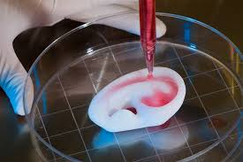
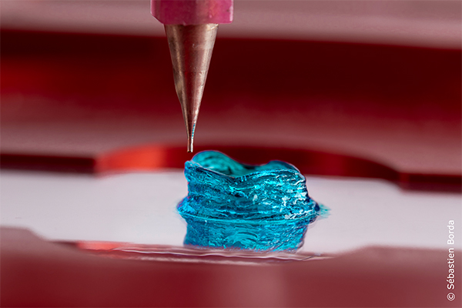
Thank You
Q & A
Sources cited in this presentation
[1] Lei, I. M., Sheng, Y., Lei, C. L., Leow, C., & Huang, Y. Y. (2022). A hackable, multi-functional, and modular extrusion 3D printer for soft materials. Scientific Reports, 12(1). https://doi.org/10.1038/s41598-022-16008-6
[2] Dillard, D. A., Mukherjee, B., Karnal, P., Batra, R. C., & Frechette, J. (2018). A review of Winkler’s foundation and its profound influence on adhesion and soft matter applications. Soft Matter, 14(19), 3669–3683. https://doi.org/10.1039/c7sm02062g
Other content: photographs of experimental results not referenced
24
24
Notes:
That’s everything, thanks for listening, and we’ll go to qna

